Slide 1
MSc Education Supporting Infrastructure
Emil Doychev
Vladimir Valkanov
University of Plovdiv
Bulgaria

Slide 2

The core
An education portal
Based on Liferay framework
Contains core learning tools:
  SCORM 2004 R4 Engine
  Test Engine
  Event Engine
  Registration Services
User Interface
Administrative Services
Personalization
Integration wit external systems
e-Services
Learning Content
e-Testing
Event Management
Engines
SCORM
Engine
Test
Engine
Event
Engine
Digital Libraries
Catalogue

Slide 3
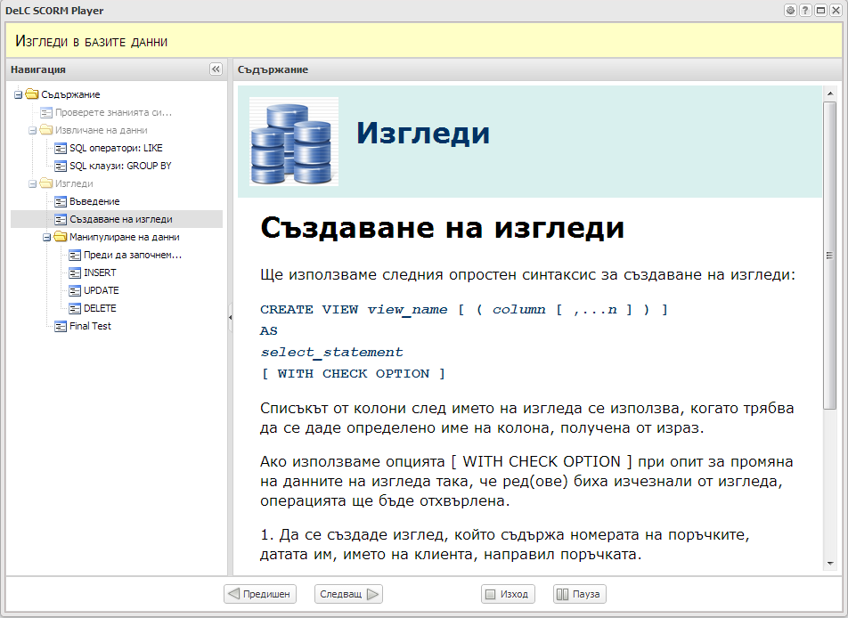
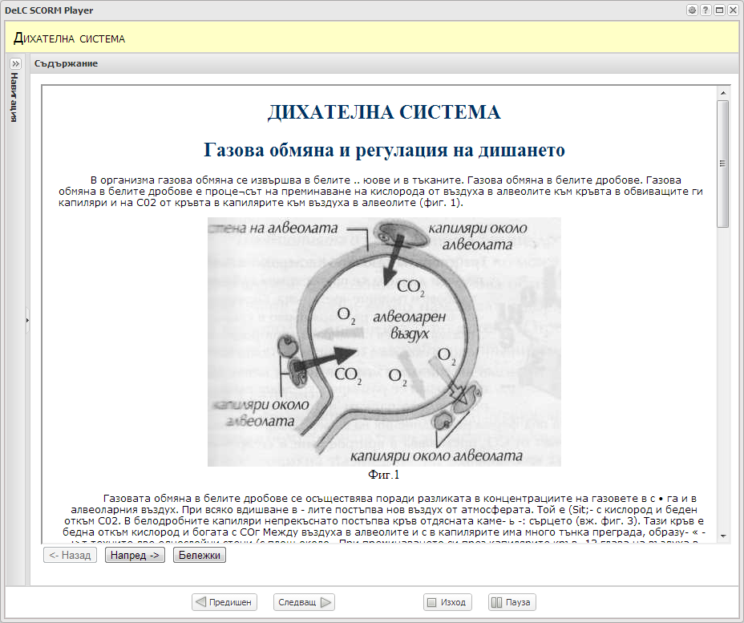
SCORM Engine
Client Components
Runtime Environment API
SCORM Engine
Resources
JSON
Player Portlet
Resource Controller
Sequencing & Navigation Engine
Storage Service
Security Manager
The last SCORM 2004 R4 release
The first Bulgarian SCORM Player
ADL certification in progress
Ongoing integration with a teacher’s monitoring tool
First real usage in few months:
  Software Technologies
  Java
  Object Oriented Programing
  Databases
  Software Design Patterns
SCORM Repository
State Database
Package Manifest
Package Resources

Slide 4
Test Engine
SCORM Engine
Test
Engine
8 types of questions:
  Single choice answer
  Multiple choice answer
  Connect items – 2 types
  Open answers – 3 types (single word, short answer, long answer, automatic scoring)
Allows pseudo-unique test generation with the help of templates
New version supporting QTI 2.1 is still in development ☹
Evaluator
Fraud Detector

Slide 5

Event Engine
SCORM Engine
Test
Engine
Event
Engine
Manages user and system events
Integrated with the other modules
Supports event classification and event’s metadata
Evaluator
Fraud Detector

Slide 6
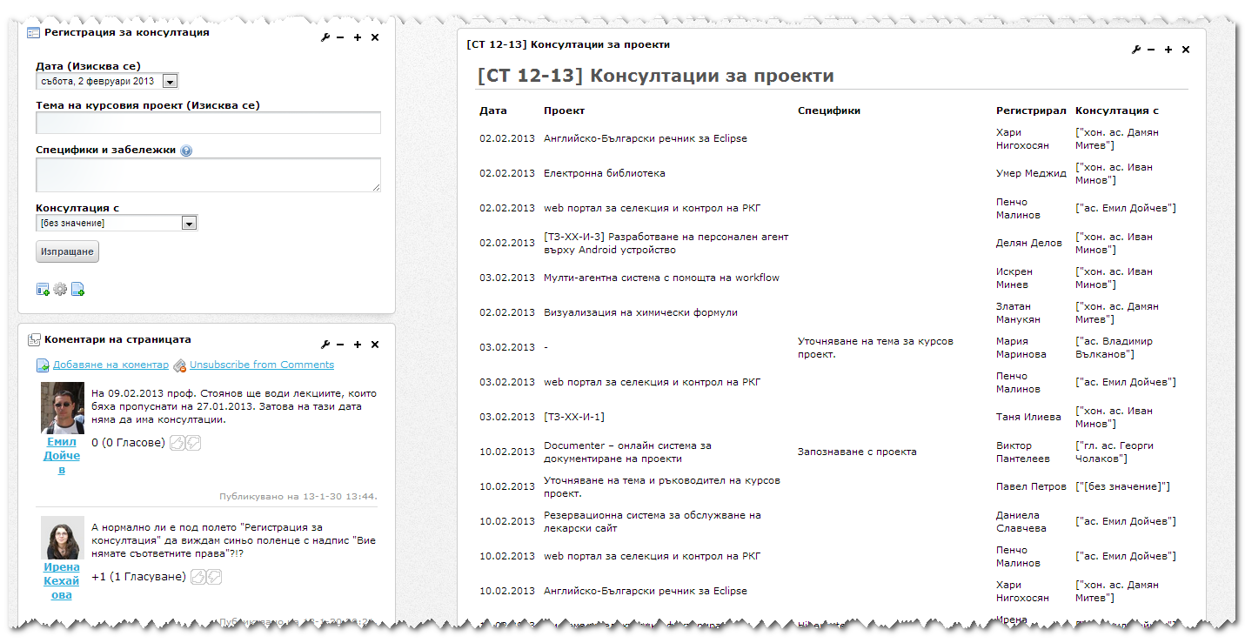
Registration Services
SCORM Engine
Test
Engine
Event
Engine
Registration Services
Evaluator
Fraud Detector
Using Liferay’s Dynamic Data List
Flexible framework for creating registration forms
Used in various scenarios:
  Consultations
  Elective courses selection
  Course projects selection
  etc.

Slide 7
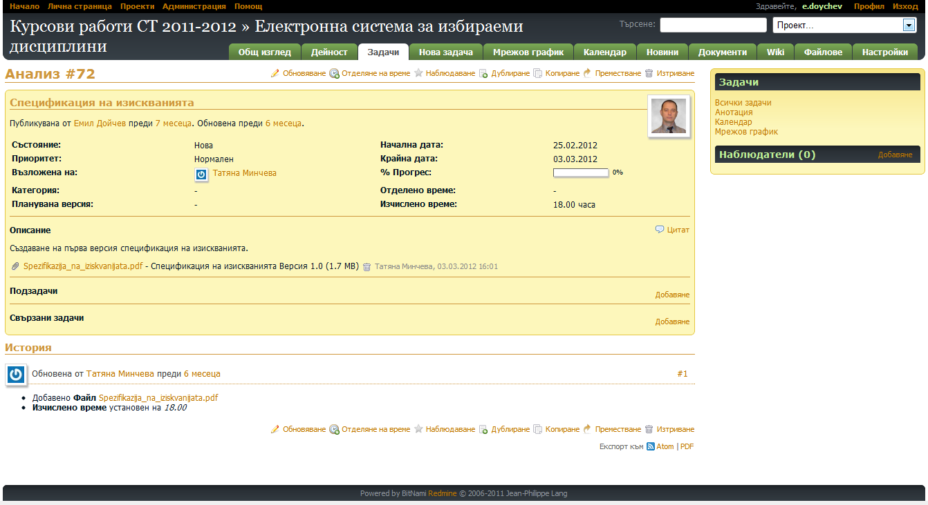
Project Management
SCORM Engine
Test
Engine
Event
Engine
Registration Services
Evaluator
Fraud Detector
Project Management
Redmine - open source and flexible project management and bug tracking system.
Integrated with DeLC and User management system.
Used for managing development of course projects (in teams) and diploma thesis (individually).

Slide 8
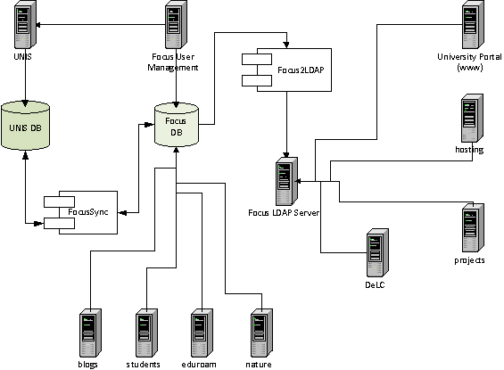
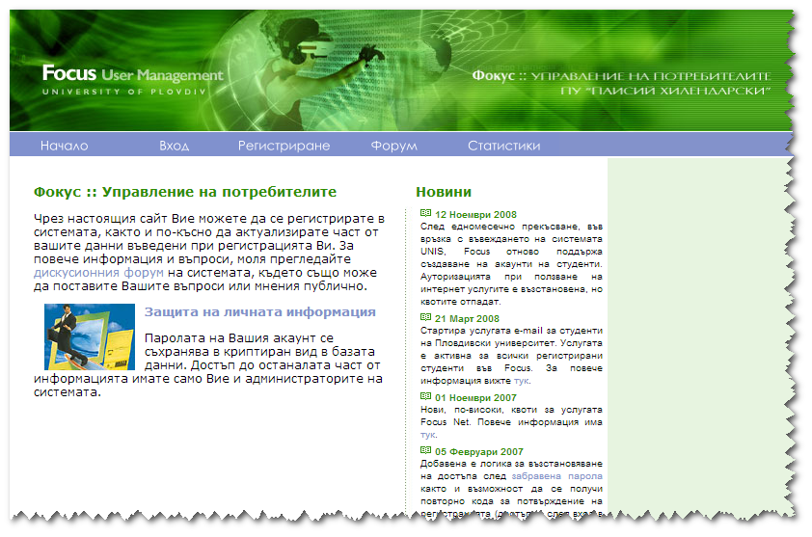
User Management
SCORM Engine
Test
Engine
Event
Engine
Registration Services
Evaluator
Fraud Detector
User Management
Project Management
Centralized user management system
Used by 11 systems
Support LDAP
Integrated with the University BIS
Running from 2005 year
Has more than 8700 active accounts

Slide 9
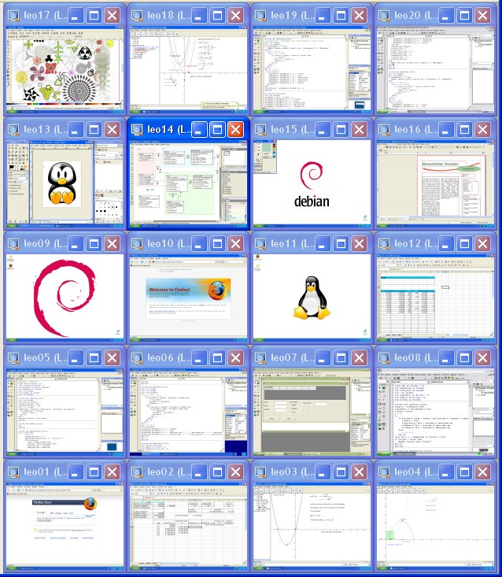

iTalc
SCORM Engine
Test
Engine
Event
Engine
Registration Services
iTALC
Allows view and control of remote computers in LAN in several ways.
It is free!
It is opensource.
Supports Windows and Linux
Can be used in mixed environment
Evaluator
Fraud Detector
User Management
Project Management

Slide 10
University BIS Integration
SCORM Engine
Test
Engine
Event
Engine
Personalization and adaptation are key concept for DeLC.
DeLC needs rich user profile with detailed information.
It is very hard requirement for DeLC.
Integration with university BIS is the right decision.
Registration Services
Evaluator
Fraud Detector
User Management
Project Management
Integration Layer
University BIS

Slide 11
MSc Education Supporting Infrastructure
SCORM Engine
Test
Engine
Event
Engine
Registration Services
Evaluator
Fraud Detector
User Management
Project Management
Integration Layer
University BIS

Slide 12
Next Level

